Slide 1
WELCOME

Slide 2

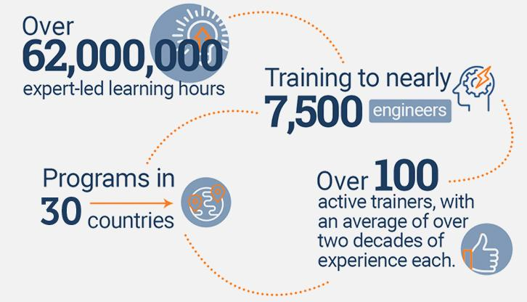
An Overview
Our purpose…
We help organizations learn and adopt new technologies.
In 2018 alone...
…Impacts you daily.
When you talk on the phone, watch a movie, connect with friends on social media, drive a car, fly on a plane, pay with a credit card, shop online, and order a latte with your mobile app, you are interacting with technology developed by one of our customers.
Notes:
Share a bit about DevelopIntelligence
- As developers you want to learn!
- As a corporation you want your developers to align their learning with your business goals.
- That’s where we come in… Keeping developers current, bringing others up-to-speed … all aimed at moving your business forward!
- We started in 2003 by a Sun Microsystems developer that wanted to help developers level-up and see business better leverage IT

Slide 3
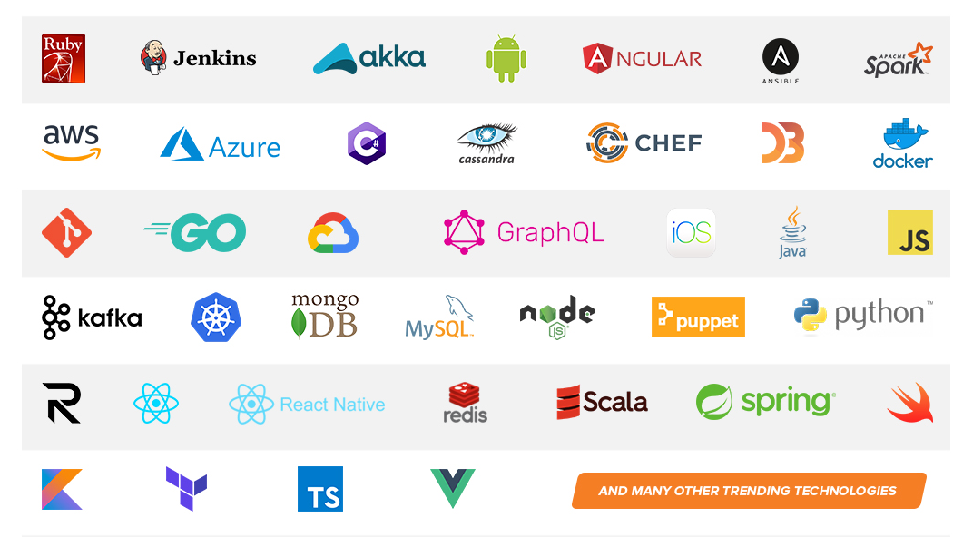
Technologies we cover
Notes:
Areas of DevelopIntelligence expertise
DevOps: Ansible / Jenkins
BigData: Hadoop / Cassandra / Spark
Machine Learning
Front-end: React / Angular
Cloud: AWS / Azure / Google Cloud
- Started as a Java shop -> keep growing -> haven’t looked back
- Our specialty is hiring expert practitioners that can come alongside teams and teach them how to move forward

Slide 4
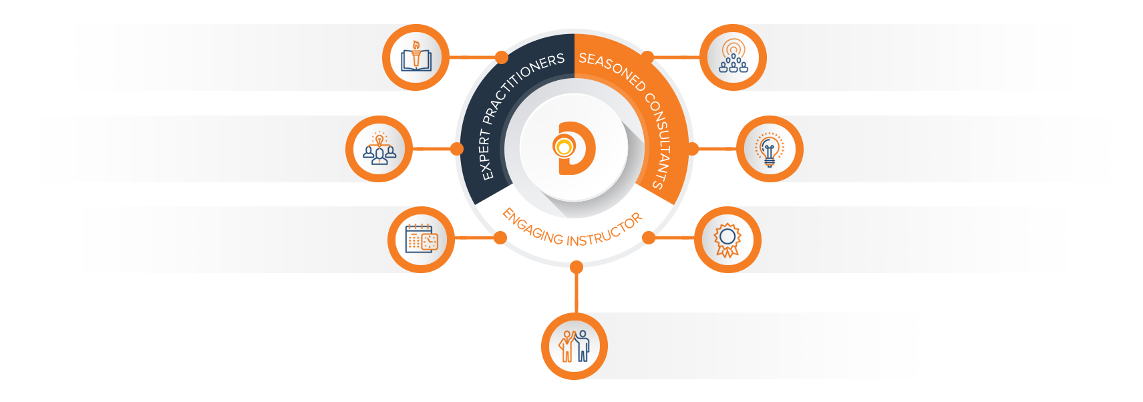
Our Practitioners
250 best selling
books authored
150 engagements speaking
at industry conferences
9+ years of training
experience
Over 17 years of industry
experience per instructor
750,000 practitioner led
training hours
125 certifications in leading
technologies
95% instructor satisfaction

Slide 5
About the instructor

Slide 6
Microservices and Golang
Fernando Pombeiro

Slide 7
Agenda
Agenda:
This class is designed to offer an overview of a microservices production environment using Golang and Kubernetes. We will be covering:
Module One:
Setting up a Microservices Architecture
Microservices architecture patterns

Slide 8
Agenda
Agenda:
Module Two:
Concurrency patterns within golang
Parallel workers
Concurrency
Memory management
Setting up multiple concurrent workers
Module Three:
Multi-stage deployment of Docker containers
Building effective Binary containers

Slide 9
Agenda
Agenda:
Module Four:
Managing Kubernetes clusters
Utilizing SQS, Kinesis, SNS
Setting up a producer/consumer module
Effective Kubernetes Microservices Designs

Slide 10
Microservices
How we used to do things
Single PRODUCTION server
Production environment
Stack traces
All Code existing in a single place

Slide 11
Monolithic Applications
A monolithic application is built as a single unit.
Enterprise Applications are built in three parts:
a database (consisting of many tables usually in a relational database management system)
a client-side user interface (consisting of HTML pages and/or JavaScript running in a browser)
a server-side application.

Slide 12
Monolithic Applications
This server-side application will handle HTTP requests
They will then execute some domain-specific logic, retrieve and update data from the database, and populate the HTML views to be sent to the browser.
It is a monolith – a single logical executable. To make any alterations to the system, a developer must build and deploy an updated version of the server-side application

Slide 13
Microservices applications
So when we deploy monolith applications there are several considerations for us…
We need to make sure that we understand how the code we’re deploying is going to effect the other pieces of code in the infrastructure.
We need to understand how package updates are going to affect other parts of the application (getting v10 vs v9 for example)
We need to make sure that all of our connectors remain functional
Debugging can be challenging
Testing is easy (and essential!)

Slide 14
Microservices
In contrast to a lot of that, microservices exist on the single responsiblility principle…which states:
“Every every module or class should have responsibility over a single part of the functionality provided by the software, and that responsibility should be entirely encapsulated by the class, module or function. All its services should be narrowly aligned with that responsibility”

Slide 15
Microservices
Most of us have been using the Single Responsibility Principle when we code on a regular basis (unless you are doing monolith coding…which I highly doubt).
Generally, if all of us are at least intermediate coders, when we code:
Every class that we create has a single job
The job has a single job that is encapsulated in that class (or function)

Slide 16
Microservices
Robert C. Martin (Uncle Bob) – one of the authors of the Agile Manifesto- put it this way:
"A class should have only one reason to change”
Now extend that out to FUNCTIONS. Further extend that out to DOCKER CONTAINERS and we have some idea of where this comes in.

Slide 17
The Single Responsibility Principle
The Single Responsibility Principle is about more than just “make small chunks of code”.
There are frequent misunderstandings that suggest that SRP just means “break large classes into smaller chunks”
This is not centrally what SRP is about. The SRP is, in shorthand from the creator, about: limiting the impact of change
Another way of putting this is:
“Gather together the things that change for the same reasons. Separate those things that change for different reasons.” –Robert C Martin

Slide 18
The Single Responsibility Principle
What Martin is talking about primarily is that we want to anticipate changes as much as possible and modularize to minimize the impacts that classes can have on each other.
Thanks to containerization we can actually fully separate our functions into Single Responsibilities
It’s not about the AMOUNT of code that goes into a single container…it’s about maintaining the SRP

Slide 19
SRP Example
So I want to tell a story about moving from a monolith service to a microservice system on the SRP.
I’m taking this from a MEDIUM article here because it’s a great example of how to make the move from a NON-SRP to an SRP system. Here’s the initial setup

Slide 20
CASE STUDY

Slide 21
SRP Example
In a nutshell, Icebreaker depended on too many other services to function properly. Let’s look at some of the tasks Icebreaker performed in order to create a channel:
Authorise the API call: This made a call to our authentication service.
Fetch the customer profile: This required an HTTP call to our customer service.
Fetch the drivers’ profile: This required an HTTP call to our driver service.
Verify if the customer-driver pair are in an active order: This made a call to our active booking storage service.
Create the channel.

Slide 22
SRP Example
The takeaway here is that if any of these services failed, the channel would fail

Slide 23
SRP Example
Step One: Remove the authentication api call…
Key takeaway: Tell, don’t ask. The requests coming from the API gateway told the service that they were authenticated, rather than Icebreaker having to ask another service.

Slide 24
SRP Example
Step Two: Remove the Chat token (only used by icebreaker)
If your service is the only one using any piece of information, it should reside within the service itself

Slide 25
SRP Example
Step Three: Separate into worker/server and Cache!
Key takeaway: Again, tell, don’t ask. The events coming from our data pipeline told Icebreaker that the bookings were genuine. This meant it could create the channel, instead of hitting a service to verify the authenticity of the booking.

Slide 26
Microservices and SRP
Hopefully by now it’s obvious how Single Responsibility plays a key role in creating an effective Microservices architecture.
Each microservice you design has ONE JOB and, as a microservice this means that it is completely isolated from other microservices.
THERE ARE DISADVANTAGES TO THIS SYSTEM!
Can you list some?

Slide 27
Microservices Disadvantages
The biggest disadvantage is that YES- you will have repeated code.
In a structure where an object needs to be reused it’s tough to simply “Abstract out” a key object and allow it multiple uses throughout a microservices architecture….
This is why the SRP is part of this system but the rest of “OLID” in the SOLID software design is not

Slide 28
Microservices Advantages
The advantages of microservices are, however, numerous…and they include:
Isolation means that you don’t “Take the stack down”
Choosing the tech stack can change
Changing components and not having to worry about follow on effects to the rest of the stack
Deployments of smaller pieces of code
Bug hunting made easy

Slide 29
Creating microservices architectures
Here’s the bad news: TO DATE no one has created a universally accepted set of principles for “Transitioning to Microservices”
Instead you’ll want to look at your system through the lens of SINGLE RESPONSIBILITY PRINCIPLES and see how we can “decompose” them into corresponding “BUSINESS CAPABILITIES”

Slide 30
DECOMPOSING YOUR MONOLITH
Here’s how to think about this:
SERVICES are how we define each “piece” of our microservices architecture
So thinking about what it is your monolith actually does let’s try to break it down into a group of interests.
THIS is “DECOMPOSING”

Slide 31
DECOMPOSING YOUR MONOLITH
So, as an example…let’s say you had a monolith online store. Here are some business capabilities that you might think about breaking out into services:
Product Catalog Management
Inventory Management
Order Management
Delivery Management
User Management
Product Recommendations
Product Reviews Management

Slide 32
DECOMPOSING YOUR MONOLITH
THIS is the list of services you will be providing in your microservices.
Armed with these you can go out and create docker containers (several docker containers per service are fine) to manage each of these aspects.

Slide 33
Building and Deploying your New System
After deciding on the service boundaries of these small services, they can be developed by one or more small teams using the technologies which are best suited for each purpose.
For example, you may choose to build a User Service in Java with a MySQL database and a Product Recommendation Service with Scala/Spark.

Slide 34
Building and Deploying your New System
Once developed, CI/CD pipelines can be setup with any of the available CI servers (Jenkins, TeamCity, Go, etc.) to run the automated test cases and and deploy these service independently to different environments (Integration, QA, Staging, Production, etc).

Slide 35
Building and Deploying your New System
Once developed, CI/CD pipelines can be setup with any of the available CI servers (Jenkins, TeamCity, Go, etc.) to run the automated test cases and and deploy these service independently to different environments (Integration, QA, Staging, Production, etc).

Slide 36
Microservices Architecture Patterns

Slide 37
Common Design errors (this is wrong)

Slide 38
WHY??
Question:
Considering the last two slides- WHY is option two better??
(THINK ABOUT CHANGES!!)

Slide 39
Microservices Patterns: Chaining

Slide 40
Communication between Services
So how should we set up our communication here?
Simple:

Slide 41
Communication between Services
Centralized “BUS” system:

Slide 42
Communication between Services
Another is a “Fan out” system:

Slide 43
Microservices Patterns: Multiple Demand APIs

Slide 44
AWS SQS vs Kinesis Demo
We’re going to stop here and demonstrate how to deploy the following elements to AWS (so that you can utilize the patterns we are going over here:
SQS Demo
Kinesis Demo
SNS Demo
Lambda Demo

Slide 45
BREAK OUT
We’re going to do breakout sessions now. I want all of you guys to take a monolith example and break out into groups and discuss.
Considering our examples please discuss a monolith that you have at Nutanix and how we can break that piece down into smaller modules.
Once you have done this please come back ready to discuss.

Slide 46
Confused? ASK QUESTIONS

